Slide 1
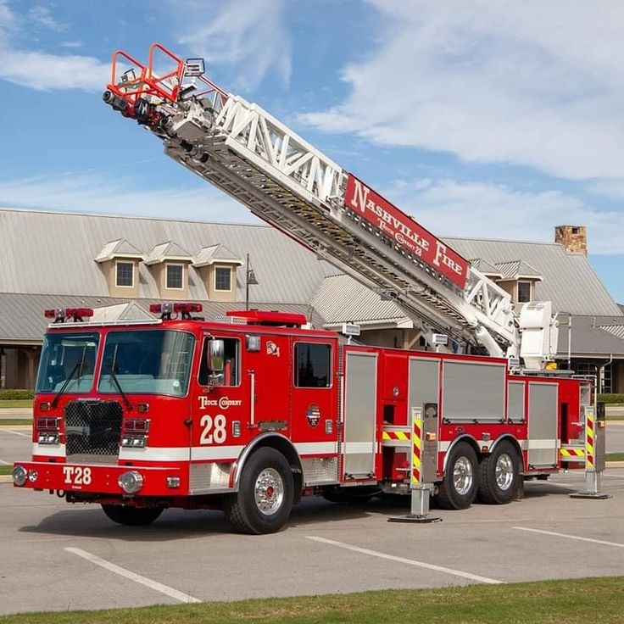
Barangay Vehicle
Management System
Evidence review and defense preparation
Illustrative vehicle mockup
24 October 2026
Notes:
Purpose: explain the seven evaluation criteria using evidence available as of 24 October 2026. Current application revision: 72d754c. This is a preparation deck, not a claim of completed field validation. Source: README.md; VMS Docs/Sample-Data.md; VMS Docs/System-Audit-2026-10-24.md. Cover photo: existing project mockup, backend-api/public/mockups/vehicles/firetruck-03-ladder-28.jpg. Asset licensing remains part of the documentation review.
PRESENTER GUIDE: This expanded deck keeps the original 19 topic slides and adds 18 concrete example companions. Use the examples to practice actions, expected results and explanations. Examples involving real-user research are proposed procedures, not completed studies. Rehearse the repair, reassignment and schedule branches on isolated sample data and reset before repeating mutually exclusive scenarios.

Slide 2
Current assessment
Criterion | Current assessment
Originality and relevance | Relevant design. Community evidence still needed.
Research quality | Literature review, method and dataset unverified.
Technical quality | Local functionality demonstrated. Six findings remain open.
Results and validation | Technical evidence exists. Field effectiveness unverified.
Documentation and ethics | Technical references exist. Manuscript and permissions unverified.
Presentation and defense | Evidence available. Team understanding needs rehearsal.
Practical impact | Potential benefit. Deployment and adoption need validation.
2
Notes:
Use supported, partly supported and unverified as evidence descriptions, not numerical grades. Unverified means the reviewed materials did not establish the claim. It does not mean that the team has no such evidence elsewhere. Source: repository review at 72d754c; pasted assessment supplied by the user; VMS Docs/Must-Haves.md; System-Audit-2026-10-24.md.
FOLLOW-ALONG EXAMPLE: The next slide gives a concrete practice case. Use the sample dataset, actual current screen labels and expected results. Research procedures remain proposals until the team carries them out.

Slide 3
Example: an answer backed by evidence
Action | What to show or say
Open Sample-Data.md | Show the recorded 489-test result and separate-checkout verification.
Open the current audit | Identify the six open findings instead of claiming complete security.
Answer the panel | The prototype works locally. Community effectiveness still needs evaluation.
Technical evidence and community validation support different claims.
3
Notes:
Open VMS Docs/Sample-Data.md and System-Audit-2026-10-24.md. Say: We can demonstrate technical functionality and reproducible setup, but cannot yet claim measured community impact. The 489-test figure is the recorded result at revision 72d754c, not a new run performed for this edit.

Slide 4
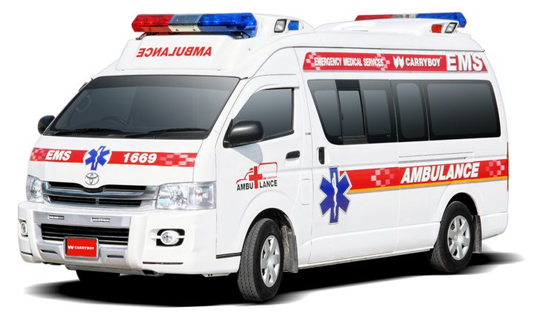
The problem and the intended users
System objective
Keep a current record of emergency-vehicle readiness and accountable maintenance.
Direct users
Barangay Admins, Custodians and Maintenance Personnel.
Evidence still needed
Interviews, current forms and real examples that establish the local problem.
Illustrative vehicle mockup
4
Notes:
Answer criteria 1b, 1c, 7a and 7b. Residents are potential indirect beneficiaries. Do not claim documented downtime or response delays unless the team has actual records. The repository defines the intended problem but does not establish how often it occurs in the community. Sources: README.md purpose and scope; VMS Docs/Documentation.md sections 1 and 3. Photo: bundled project mockup ambulance-01-hiace-carryboy.jpg.
FOLLOW-ALONG EXAMPLE: The next slide gives a concrete practice case. Use the sample dataset, actual current screen labels and expected results. Research procedures remain proposals until the team carries them out.

Slide 5
Example: a barangay readiness question
Step | Follow-along example
Ask the question | Which ambulance has current readiness evidence?
Open View Vehicles | Compare INEM Portuguese Ambulance with Rescue Response Ambulance.
Explain the indicators | INEM starts with a passing check. Rescue Response starts Needs Inspection.
Validate the problem | Ask actual staff how they currently obtain this information.
The interview question is proposed. No interview result is claimed.
5
Notes:
Use Admin or Custodian. Find INEM-112 and FDR-303. Reset before rehearsal if checks are stale. Do not equate Available with verified readiness. Ask actual users where they record defects and confirm repair completion, then retain authorized real responses. Source: Sample-Data.md.

Slide 6
A meaningful design contribution
Indicator | What it tells the user
Availability | Whether the vehicle is available or undergoing maintenance.
Physical condition | Whether it is Good, Needs Inspection or Needs Repair.
Verified readiness | Whether a recent checklist supports readiness for use.
The workflow also records repair responsibility and independent verification.
6
Notes:
Answer criterion 1a. These indicators describe different questions. Available alone does not certify verified readiness. A passing readiness check normally expires after 24 hours. Explain the contribution as an application suited to a barangay workflow. Do not claim global novelty or measured improvement over an existing process without comparative evidence. Source: System-Capabilities.md sections 3.1 and 3.7. Caveat: the stale-readiness finding after parts removal remains open, AUD-24-04.
FOLLOW-ALONG EXAMPLE: The next slide gives a concrete practice case. Use the sample dataset, actual current screen labels and expected results. Research procedures remain proposals until the team carries them out.

Slide 7
Example: three vehicle indicators
Sample vehicle | Starting state to explain
Ladder Company 28 | Available and Good. A fresh pass supports verified readiness.
Rescue Response Ambulance | Available but Needs Inspection. It has no passing readiness check.
Barangay Fire Responder | Under Maintenance and Needs Repair. Its repairs remain unfinished.
These states describe the reset demo. Passing checks age normally after 24 hours.
7
Notes:
Open each vehicle profile and point to availability, condition and readiness separately. Counts change when demonstration work finishes. Source: Sample-Data.md and System-Capabilities.md. The stale-readiness issue after parts removal remains open under AUD-24-04.

Slide 8
Maintenance responsibility
Step | Responsible person | Recorded result
Proposal | Custodian | Pending Approval ticket with repair details.
Review | Admin | Approval, assignments or a decline reason.
Repair | Assigned mechanic | Repair log and supporting evidence.
Verification | Assigned Custodian | Independent check or return for rework.
Closure | System after approval | Closed ticket and maintenance history.
For external-shop repairs, the Admin handles the shop work. The handler cannot verify it.
8
Notes:
Explain the current ticket lifecycle. The proposing Custodian may later verify if independent of the repair. A second Custodian is not mandatory. A repairer cannot verify their own work. Different in-house sub-issues may have different assigned mechanics. External-shop handling stays within maintenance scope. Sources: TicketController.php; config/permissions.php; System-Capabilities.md section 5. The slide describes intended workflow guards and does not claim every authorization path is defect-free.
FOLLOW-ALONG EXAMPLE: The next slide gives a concrete practice case. Use the sample dataset, actual current screen labels and expected results. Research procedures remain proposals until the team carries them out.

Slide 9
Example: the fire-truck repair handoff
Role | Action and expected result
Admin | Open BFP-5501 Active ticket. Check the Jake and Rohan assignments.
Jake | Log the pump-seal repair. Another line remains, so the ticket stays Active.
Rohan | Log the pressure-regulator work. The last repair triggers verification.
Precious | Open My Tasks and independently approve or return the repair.
This is a software rehearsal. Physical repairs and checks are simulated.
9
Notes:
Start from the reset sample dataset. Accounts: maintenance@barangay.gov for Jake, maintenance2@barangay.gov for Rohan, custodian@barangay.gov for Precious. Sample notes: Replaced the sample pump seal and checked for leakage. Rohan logs regulator observations. The assigned Custodian receives the handoff after all required repairs are logged. Never certify real physical work from a software demonstration.

Slide 10
Related literature
Research theme | What the review must establish
Maintenance management | How comparable systems document repair and preventive work.
Emergency-fleet readiness | How studies distinguish availability from readiness.
Access and accountability | Why ownership checks and independent verification matter.
Research gap | What the barangay needs that existing approaches do not address.
A complete literature review was unavailable for verification.
10
Notes:
Answer criterion 2a. These are proposed review themes, not citations to studies already reviewed. The team needs authentic literature, a comparison matrix and a synthesis that connects evidence to its design. Do not invent studies or describe vendor pages as empirical evidence. The current review did not find a complete assessable manuscript in the supplied materials.
FOLLOW-ALONG EXAMPLE: The next slide gives a concrete practice case. Use the sample dataset, actual current screen labels and expected results. Research procedures remain proposals until the team carries them out.

Slide 11
Example: a literature-review worksheet
Field | What the team should record
Comparison question | How do maintenance systems prevent a repairer from verifying their own work?
Actual source | Read a real study and record its author, year and publication.
Extraction | Record the actual method, finding and limitation.
Design connection | Compare the finding with the independent Custodian verification rule.
Worksheet example only. It does not supply or invent a published study.
11
Notes:
Open the team's real literature matrix. Suggested columns: author/year, setting, method, actual finding, limitation and relevance to VMS. Do not cite fictional papers or unverified claims. Project code supports implementation claims but does not replace related literature. This research task remains unfinished until actual sources are reviewed.

Slide 12
Research methodology
Part of the method | Evidence the team needs
Requirements gathering | Participants, interview guide and confirmed requirements.
Development process | Actual iterations, changes and reasons for design decisions.
Evaluation design | Representative roles, tasks, instruments and sampling rationale.
Data analysis | Scoring rules, task measures, dataset and stated limitations.
This is a proposed evidence plan. The team must document the method it actually followed.
12
Notes:
Answer criteria 2b and 2c. Do not label the project Agile or prototyping merely because it underwent revisions. Separate the software-development method from the research-evaluation method. Dashboard statistics are system output, not a substitute for research analysis. Choose analysis appropriate to the measures and participants, and justify the choices with the adviser.
FOLLOW-ALONG EXAMPLE: The next slide gives a concrete practice case. Use the sample dataset, actual current screen labels and expected results. Research procedures remain proposals until the team carries them out.

Slide 13
Example: one proposed evaluation task
Stage | Concrete activity
Participant | Recruit an actual authorized Maintenance Personnel participant.
Task | Ask them to find today's INEM service and explain how to record completion.
Observation | Record elapsed time, errors, assistance and task completion.
Analysis | Report observed results with the sample and its limitations.
Proposed procedure. Participant counts and results remain unverified.
13
Notes:
Use a sample database and obtain required participation permission. Define consistent task instructions and start/stop events. Record assistance. Do not invent timings, success rates or satisfaction scores. Explain the actual development process separately from this evaluation method and obtain the adviser's guidance.

Slide 14
System architecture
Component | Verified role or current status
React and Vite frontend | Role-based workspaces and maintenance interfaces.
Laravel API | Validation, permissions and workflow transitions.
Sanctum authentication | Bearer tokens identify authenticated accounts.
SQLite | Demonstrated local database and demo setup.
PostgreSQL and cloud storage | Deployment targets requiring target-host acceptance.
Maintainability limitation: much of the interface remains in one large Workspace component.
14
Notes:
Answer criterion 3a. Architecture, ERD and use-case files exist. Their existence does not certify complete alignment with current code. PostgreSQL/Supabase deployment is not established by the local SQLite demonstration. Sources: backend-api/composer.json; frontend-spa/package.json and package-lock.json; README.md; System-Architecture.svg; ERD.svg; Use-Case-Diagram.svg. Workspace.jsx remains a substantial maintenance concern.
FOLLOW-ALONG EXAMPLE: The next slide gives a concrete practice case. Use the sample dataset, actual current screen labels and expected results. Research procedures remain proposals until the team carries them out.

Slide 15
Example: a repair submission
Layer | What happens
React interface | Jake submits notes for his assigned fire-truck repair.
Laravel API | The endpoint checks the account, assignment and workflow state.
SQLite | The application stores repair evidence and updates the repair line.
Interface refresh | The page refreshes. Handoff waits until all required repairs are logged.
Explain the earlier submission. A second repair submission is unnecessary.
15
Notes:
If showing browser Network tools, explain the actual request and response using current record IDs. Keep bearer tokens hidden. Endpoint pattern: PUT /api/tickets/{ticket}/sub-issues/{subIssue}/log-repairs. SQLite is the demonstrated local database. PostgreSQL deployment needs separate evidence. Source: TicketController.php and README.md.

Slide 16
Technical testing evidence
489
2,339
11
Backend tests passed
Assertions
Demo photo files matched
The frontend build passed in a separate checkout after dependency installation.
Recorded results at revision 72d754c. Existing tests do not close the six audit findings.
16
Notes:
Answer criterion 3d and the technical part of criterion 4a. These are recorded results from the preceding verification, not a newly conducted field study. Nine focused setup/sample checks contributed 94 assertions. A separate checkout installed locked Composer/npm dependencies, migrated and seeded SQLite, matched the semantic demo data and all 11 photo files, preserved environment files on rerun and created valid backups. Earlier reports include targeted browser checks. Sources: VMS Docs/Sample-Data.md verification section; backend-api/tests/Feature/SampleFleetSeederTest.php; SyncDemoTest.php. Test counts do not establish uptime, security completeness or user effectiveness.
FOLLOW-ALONG EXAMPLE: The next slide gives a concrete practice case. Use the sample dataset, actual current screen labels and expected results. Research procedures remain proposals until the team carries them out.

Slide 17
Example: reproducible test evidence
Step | Command or demonstration
Backend terminal | In backend-api: php artisan test --filter=SampleFleetSeederTest
Explain the result | Read the actual result and exit status. Tests use an isolated database.
Frontend terminal | In frontend-spa: npm run build
Explain the scope | The recorded full run passed 489 tests. Field effectiveness remains separate.
Prepare dated output or a recording in case a command takes too long.
17
Notes:
Do not run demo:sync during the live story because it resets demo work. Sample tests do not complete live demonstration tickets. If running the full suite, use php artisan test and report its actual current count. Existing regressions do not close the six audit findings. Optional Metro rework branch: Precious returns AMB-1101 with a reason, Jake records rework, and Precious independently verifies again.

Slide 18
Six open audit findings
ID | Priority | Finding
01 | High | A response can sign an inaccessible managed-file reference.
02 | High | Direct issue details bypass list visibility restrictions.
03 | High | Shared catalog edits affect other barangays and history.
04 | High | Parts removal leaves an earlier readiness pass current.
05 | Medium | CSV exports retain formula-leading untrusted text.
06 | Medium | Schedule completion accepts future dates.
Security and workflow acceptance remain incomplete until fixes pass rejection-based tests.
18
Notes:
Answer criterion 3c accurately. IDs abbreviate AUD-24-01 through AUD-24-06. Findings were reproduced in isolated investigation and remain open. Six passing investigation tests asserted defective behavior and therefore did not establish fixes. CSV spreadsheet behavior depends on the receiving application. Do not claim cross-barangay file access from the same-barangay signing probe. Source: VMS Docs/System-Audit-2026-10-24.md. Recent sample/setup changes do not resolve these issues.
FOLLOW-ALONG EXAMPLE: The next slide gives a concrete practice case. Use the sample dataset, actual current screen labels and expected results. Research procedures remain proposals until the team carries them out.

Slide 19
Example: open-finding acceptance checks
Finding | Required result to demonstrate
File signing | An inaccessible file reference must not produce an authorized download.
Issue visibility | Report details must honor the same access rules as the list.
Shared catalogs | A barangay edit must not silently rewrite another tenant's history.
Readiness | A relevant parts-removal event must invalidate earlier readiness evidence.
CSV export | Formula-leading input must remain safe text under the chosen export policy.
Completion date | A future completion date must fail without changing records.
All six findings remain open. These are required outcomes, not passing results.
19
Notes:
Use isolated fixtures and the existing audit report. Do not project private references or use production records. Demonstrate required rejection tests and explain current observed failures. Source: System-Audit-2026-10-24.md, AUD-24-01 through AUD-24-06. CSV behavior depends on the receiving spreadsheet application.

Slide 20
Usability and error handling
Available evidence
Evaluation still needed
Role-focused workspaces and assigned tasks
Observe representative users completing tasks
Search, filters and inline field validation
Record errors, completion and help required
Server-side refusals for invalid actions
Explain failure messages and recovery paths
20
Notes:
Answer usability and error handling in criteria 3c and 3d. Existing features suggest attention to usability, but only actual evaluation can establish usability for target users. Use representative devices and accessibility needs. Test incorrect input, denied access, network loss and retry behavior as appropriate. Do not convert a developer walkthrough into a user satisfaction result. Sources: System-Capabilities.md interface conventions; backend feature tests; Must-Haves.md acceptance section.
FOLLOW-ALONG EXAMPLE: The next slide gives a concrete practice case. Use the sample dataset, actual current screen labels and expected results. Research procedures remain proposals until the team carries them out.

Slide 21
Example: recovering from missing input
Step | Action and expected result
Open the proposal form | Sign in as Custodian and start a maintenance proposal.
Leave a required field empty | Try to continue without the required vehicle or repair details.
Observe the response | Show the actual validation message and that no valid proposal was created.
Correct the input | Fill the missing value, then cancel this example instead of adding extra work.
Show actual behavior. Some forms still use summary-style validation.
21
Notes:
This scenario avoids changing the main repair story. Explain the message, focus behavior and correction path. For actual usability evaluation, observe whether users understand and recover without help. A developer walkthrough is not a measured user-satisfaction result. Source: current proposal form and System-Capabilities.md interface conventions.

Slide 22
Results and validation
Supported claim | Evidence still needed for stronger claims
Core maintenance workflows run locally. | User acceptance with representative roles and records.
The shared demo can be recreated. | A deployment pilot with actual operating constraints.
SQLite backup creation was demonstrated. | Restore verification and recovery on the target host.
Tests check selected controls and failures. | Coverage of open findings, load and service interruptions.
Reduced downtime, faster response and higher productivity remain unmeasured outcomes.
22
Notes:
Answer criteria 3b and 4a. Technical operation differs from effectiveness in a real barangay. For example, compare how long staff need to locate current vehicle readiness using the existing process versus the system. Predefine tasks and metrics before gathering results. Keep raw anonymized data, expected/actual test results and participant feedback. Never invent UAT respondents, scores or improvement percentages. Source: Must-Haves.md acceptance checks; Sample-Data.md; System-Audit-2026-10-24.md.
FOLLOW-ALONG EXAMPLE: The next slide gives a concrete practice case. Use the sample dataset, actual current screen labels and expected results. Research procedures remain proposals until the team carries them out.

Slide 23
Example: an evaluation results sheet
Measure | How to record it
Task success | Record whether the participant completed the defined task.
Completion time | Record actual start and finish times using the same rule.
Errors and assistance | Record observed mistakes and each intervention.
Comparison | Use comparable existing-process and VMS tasks before claiming improvement.
Leave results unfilled until observation. No improvement percentage is established.
23
Notes:
Example task: identify current readiness evidence or retrieve a maintenance record. Record an anonymized participant code, role, device, task, expected/observed outcomes, elapsed time, errors and assistance. Preserve raw data and explain sample limitations. Dashboard values do not replace research analysis.

Slide 24
Documentation, permissions and privacy
Current position
Required evidence
Technical references and diagrams exist
Align manuscript, slides, manuals and code
The full manuscript and citation list remain unverified
Confirm data and image-use authorization
Permission and participant records remain unverified
Define lawful basis, access, retention and deletion
Technical access controls alone do not establish privacy compliance.
24
Notes:
Answer criteria 5a, 5b and 5c. Review every citation against the reference list and verify that the source supports the claim. Older impersonation descriptions remain inconsistent with the current dedicated Account Switcher permission. Obtain the relevant barangay/institutional authorization and participant information/consent where appropriate. A permission letter does not replace lawful processing requirements. Philippine data privacy principles include transparency, legitimate purpose and proportionality. Consent is one lawful basis, not the only one. Official source: https://privacy.gov.ph/data-privacy-act/ sections 11, 12 and 20, checked 24 October 2026. Have the adviser and responsible barangay official confirm the applicable arrangements. Also verify asset licensing.
FOLLOW-ALONG EXAMPLE: The next slide gives a concrete practice case. Use the sample dataset, actual current screen labels and expected results. Research procedures remain proposals until the team carries them out.

Slide 25
Example: privacy and permission records
Record | Concrete example to prepare
Personal data | Staff names and email addresses used for accounts and assignments.
Purpose and access | Explain why the data is necessary and which roles can access it.
Authorization | Keep actual barangay authorization and participant information records.
Retention and images | Document an approved retention rule and permission to use photographs.
Checklist example. A permission letter alone does not establish legal compliance.
25
Notes:
Include storage, lawful basis, access, retention, deletion and incident responsibilities in the data inventory. Obtain adviser and responsible barangay-official review. Consent is one lawful basis, not the only one. Do not imply signed authorization exists without evidence. Official source: https://privacy.gov.ph/data-privacy-act/, sections 11, 12 and 20, checked 24 October 2026.

Slide 26
AI assistance and accountability
AI assistance contributed to code, debugging, tests and documentation.
Disclosure
Identify the tools, their actual uses and the affected work.
Team responsibility
Explain what each proponent personally reviewed and verified.
Academic requirements
Follow the institution's disclosure policy and keep supporting records.
26
Notes:
Answer criterion 5d. AI assistance is confirmed by this work session. Do not claim that all code was manually authored, or that the proponents personally reviewed every contribution, without evidence. Automated tests and AI review do not replace the team understanding its work. This slide discloses actual categories of assistance, while the team still needs to complete a full tool/use/verification record according to school policy.
FOLLOW-ALONG EXAMPLE: The next slide gives a concrete practice case. Use the sample dataset, actual current screen labels and expected results. Research procedures remain proposals until the team carries them out.

Slide 27
Example: an honest AI disclosure
Disclosure part | Suggested wording or record
Actual assistance | ChatGPT/Codex assisted with code, debugging, tests and documentation.
Automated verification | Cite dated test results and explain their limits.
Personal team review | Record who reviewed each contribution, what they checked and when.
Responsibility | The proponents remain responsible for the submitted work and explanation.
Draft example. Complete it using actual practices and the institution's format.
27
Notes:
AI assistance and recorded automated checks are confirmed in this session. Do not claim every proponent personally reviewed all changes. Maintain a real tool/use/review log and follow school disclosure policy. Be transparent about unresolved findings and how the team checked outputs.

Slide 28
Presentation and defense
Panel question | Evidence the team should use
Why separate availability and readiness? | Explain the three indicators using a sample vehicle.
Who may verify a repair? | Show assignment and self-verification restrictions.
How did you evaluate the system? | Show test results, coverage limits and any actual UAT.
What remains unfinished? | Show the open audit, research gaps and deployment checks.
Every member should explain the method and results in their own words.
28
Notes:
Answer criteria 6a through 6d. A clear opening: Barangay VMS supports emergency-fleet readiness and maintenance accountability through reported defects, approved repair work and independent verification. Follow this with evidence of the actual community problem. Rehearse a maintenance demonstration with expected states and a return-for-rework branch. The existence of this presentation cannot establish the proponents understanding or their live delivery.
FOLLOW-ALONG EXAMPLE: The next slide gives a concrete practice case. Use the sample dataset, actual current screen labels and expected results. Research procedures remain proposals until the team carries them out.

Slide 29
Example: concise panel answers
Question | Answer to practice
Is it fully secure? | Six audit findings remain open. Full security acceptance is incomplete.
Why separate readiness? | Available alone does not establish a recent passing checklist.
What proves it works? | Tests and workflow demos support local functionality. UAT remains separate.
Who verifies repairs? | The assigned Custodian, independent of the repairer and external handler.
Show the supporting evidence immediately after answering.
29
Notes:
Practice a short answer, then open the screen or document. For security, show the audit. For readiness, compare FDR-303 and FDT-2801. For testing, open Sample-Data.md or dated actual output. For verification, show the assigned Custodian and server restrictions. Each member should explain the answer in their own words.

Slide 30
Staffing and operational feasibility
Situation | Current workflow response
One mechanic and one Custodian | The mechanic repairs. The Custodian independently verifies.
Mechanic unavailable | Admin assigns another qualified mechanic or repair work waits.
Custodian unavailable | Admin reassigns to another Custodian or verification waits.
One person holds both roles | That person cannot verify their own repairs.
The Admin cannot use impersonation to perform work under an absent employee's name.
30
Notes:
Answer practical feasibility and likely defense questions. Admin alone does not hold impersonation.start. The separate Account Switcher can switch accounts for demonstration/support. Its impersonation writes are blocked outside local development. A genuinely authorized backup Custodian may be a multi-role account, but the system still requires assignment and independence from the repair or external handling. Sources: config/permissions.php; AuthController.php canImpersonate; RestrictImpersonatedToReadOnly.php; TicketController.php verifier guards.
FOLLOW-ALONG EXAMPLE: The next slide gives a concrete practice case. Use the sample dataset, actual current screen labels and expected results. Research procedures remain proposals until the team carries them out.

Slide 31
Example: the Custodian is absent
Step | Action and expected result
Starting case | Metro EMS Ambulance waits for Precious to verify Jake's repair.
Admin action | Reassign the ticket Custodian to Justine Mae Belia.
Replacement action | Justine uses her own account and independently verifies the work.
Restriction | Precious loses the assignment. Jake cannot verify his own repair.
Use a separate rehearsal branch if you already closed the Metro ticket.
31
Notes:
Start with AMB-1101 at For Verification. Admin selects active custodian2@barangay.gov through the current Custodian reassignment action. Justine signs in independently. If no qualified replacement exists, verification waits. An Admin-only role cannot verify. Account switching is not a staffing solution. Reset before repeating mutually exclusive Metro scenarios.

Slide 32
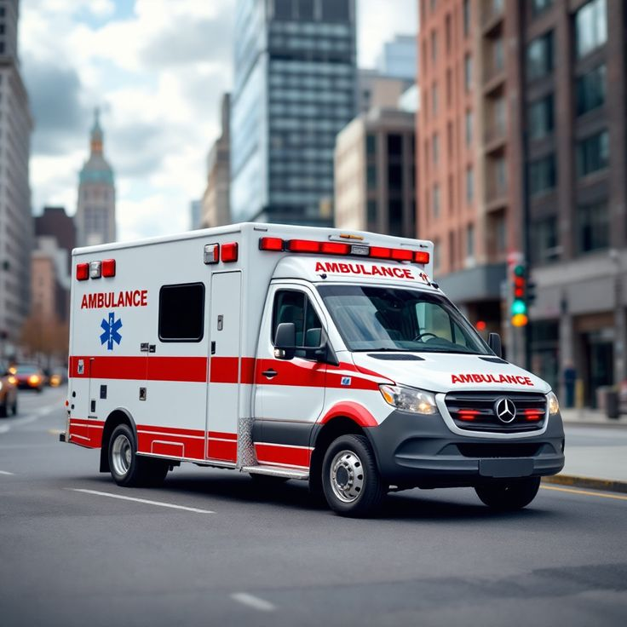
Practical impact and scope
Intended benefit
Traceable maintenance work and clearer readiness information for barangay staff.
Adoption requirements
Connectivity, suitable devices, training, support ownership and backup staff.
Current scope
Fleet readiness and maintenance. Dispatch, compliance expiry and mileage planning remain outside scope.
Illustrative vehicle mockup
32
Notes:
Answer criteria 7a through 7d. Residents may indirectly benefit from better maintained vehicles, but the project has not measured that outcome. Cost, hosting, connectivity and training must be assessed for the intended deployment. No offline operation has been demonstrated. Real target-host storage and restoration acceptance remain open. Sources: README.md scope; Must-Haves.md acceptance section; System-Audit-2026-10-24.md. Photo: bundled project mockup ambulance-02-sprinter.jpg.
FOLLOW-ALONG EXAMPLE: The next slide gives a concrete practice case. Use the sample dataset, actual current screen labels and expected results. Research procedures remain proposals until the team carries them out.

Slide 33
Example: an ambulance preventive service
Role | Action and expected result
Jake | Open his unconverted INEM schedule and choose Mark as Done.
Work record | Record the simulated service. The ledger entry awaits verification.
Custodian and Admin | Complete standalone-record verification and confirmation.
Follow-up | Show the next monthly occurrence and preserved maintenance evidence.
Complete this before running schedule-to-ticket conversion in the full-system demo.
33
Notes:
Use INEM-112: Scheduled, assigned to Jake, monthly recurrence, no resulting ticket. If conversion already created a ticket, continue through that ticket instead. The standalone record requires Custodian verification and Admin confirmation. This differs from ticket closure on Custodian approval. Dates and record numbers vary by machine. Demonstration work is simulated.

Slide 34
Work required before acceptance
Priority | Deliverable
1. Known defects | Fix the six findings and retain tests that reject the failures.
2. Research foundation | Verify the local problem, literature synthesis and actual method.
3. User evaluation | Collect representative task results and feedback.
4. Deployment evidence | Demonstrate storage, persistence, restore and failure recovery.
5. Defense package | Align the manuscript, citations, permissions and AI disclosure.
The prototype has technical evidence. Research and deployment acceptance still need evidence.
34
Notes:
Suggested preparation order, not a promise that no other defects exist. Resolve safety and authorization findings before collecting sensitive real operational records. Do not expand features to avoid the current gaps. The team and adviser should approve an achievable evaluation plan and acceptance criteria. Sources: System-Audit-2026-10-24.md retest order; Must-Haves.md acceptance checks; Sample-Data.md verification results.
FOLLOW-ALONG EXAMPLE: The next slide gives a concrete practice case. Use the sample dataset, actual current screen labels and expected results. Research procedures remain proposals until the team carries them out.

Slide 35
Example: evidence for closing one finding
Stage | What the team should produce
Before the fix | A regression test reproducing the unauthorized file-signing case.
Implementation | Parent-record authorization on every signing path.
After the fix | Unsafe access refused and legitimate authorized downloads still working.
Acceptance record | Test evidence, reviewer and revision before changing the audit status.
Proposed closure procedure. The current review still lists AUD-24-01 as open.
35
Notes:
Use the actual audit criteria. Final tests must reject unsafe behavior rather than confirm the bypass still works. Recheck ownership and tenant cases, relevant workflows and the regression suite. A presentation or documentation change cannot itself close an implementation finding.

Slide 36
Evidence and references
Technical evidence
Sample-Data.md: setup reproduction and 489-test result
backend-api/tests/Feature/: workflow and failure tests
Current limitations
System-Audit-2026-10-24.md: six open findings
Must-Haves.md: outstanding acceptance criteria
Design references
README.md, Documentation.md and System-Capabilities.md
Architecture, ERD and use-case diagrams
Privacy source
National Privacy Commission, Republic Act No. 10173
privacy.gov.ph/data-privacy-act/
36
Notes:
All repository paths refer to the V2-VMS project at revision 72d754c unless a dated audit specifies its earlier reviewed revision. Living documents and old generated PDFs may differ. Use current code and dated evidence to resolve disagreement. External source: National Privacy Commission, Republic Act 10173, https://privacy.gov.ph/data-privacy-act/, checked 24 October 2026. Speaker notes identify the source and limits for each substantive slide. The complete research manuscript, literature bibliography, signed UAT dataset and permission records were not available to this review.
FOLLOW-ALONG EXAMPLE: The next slide gives a concrete practice case. Use the sample dataset, actual current screen labels and expected results. Research procedures remain proposals until the team carries them out.

Slide 37
Example: finding evidence during questions
Panel claim | Open this evidence
The demo is repeatable. | VMS Docs/Sample-Data.md and the setup/sample tests.
Six findings remain open. | VMS Docs/System-Audit-2026-10-24.md.
Admin cannot impersonate staff. | backend-api/config/permissions.php: impersonation.start.
Privacy requires lawful processing. | National Privacy Commission: privacy.gov.ph/data-privacy-act/.
Open these references before presenting and check the revision/date.
37
Notes:
Keep evidence tabs ready. Technical test counts are dated recorded results. The impersonation permission belongs to the dedicated Impersonator role, while older documentation may differ. Sources: the repository files shown and https://privacy.gov.ph/data-privacy-act/. This example is not a complete research bibliography.

